Slide 1

IS4242 Group 8 Presentation
PowerText - Automatic content moderation for text in social media: Detecting violation of terms of service and AI content.

Slide 2
Table of Contents
01
02
03
Introduction
Dataset
Model
04
05
06
Evaluation
End Product
Extensions

Slide 3
01
Introduction
Tackling Content Moderation Challenges in Social Media

Slide 4
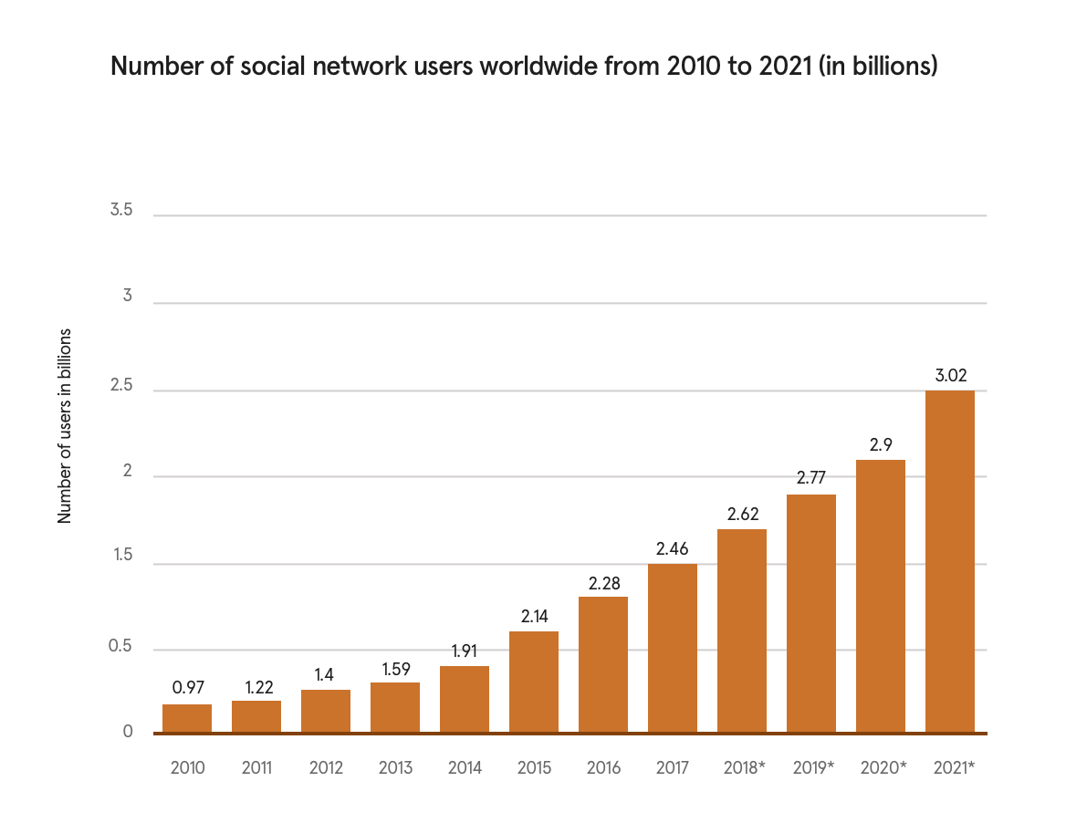
Our Problem
Users
AI Content
59% of the world’s population use social media as of Jan 2023
Platforms flooded with AI bots and content Supernew Problem!
Content Moderation
Manual content moderation is time-consuming, labor-intensive and inconsistent

Slide 5
Our Solution
Objective
Focus
Develop an automated content moderator to identify and flag violations in text content.
Hate speech, cyberbullying, spam, and distinguishing between human and AI-generated content
Tools
End Product
NLP Algorithms: NaiveBayes, PassiveAggressive, LSTM, CNN,
GRU and Transformers.
Datasets: Self-tagged Reddit dataset and AI-generated content from GPT-3.5 and GPT-4.
Platform-end automated content filtering service, and user-end post/comment input plug-in.

Slide 6
Common Violations

Slide 7
 | Facebook | Twitter | Instagram | Reddit | YouTube
Harassment | X | X | X | X | X
Cyberbullying | X | X | X | X | X
Hate speech | X | X | X | X | X
Spam | X | X | X | X | X
Impersonation | X | X | X | X | X
Violence | X | X | X | X | X
Nudity/Pornography | X | Restricted | X | Restricted | X
Privacy Infringement | X | X | X | X | X
Terrorism | X | X | X | X | X
Intellectual Property | X | X | X | X | X
Drug use | X | X | X | X | X
Advertisements | 0 | 0 | 0 | 0 | 0
Strict guideline to follow!

Slide 8
What we choose?
Hate/Harassment/Bullying
Privacy
Sexual
Impersonation
Illegal acts
Advertisement/promotions
Authenticity

Slide 9
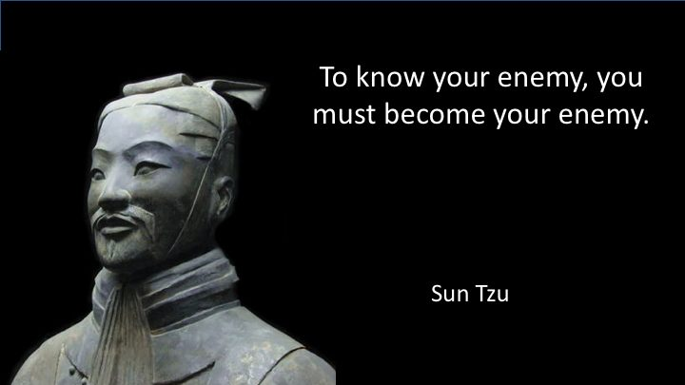
AI Content (COOL stuff!)
It is hard for us to identify AI content
We utilise chatGPT 3.5 and 4 to generate social media content

Slide 10
PowerText System Design
Source Layer
Preprocessing Layer
Reddit
PRAW
Concat
Remove punctuations, stopwords and non-alphanumeric characters.
Transform to lowercase, stem and lemmatize.
GPT3.5 / GPT4
Feedback Layer
Deployment Layer
Development Layer
Feedback Collection
Platform Regulator
Data Visualisation
Model Inference
Sentiment Analysis
Model Evaluation:
Cross-validation and Hold-out
Model Building:
Baselines, LSTM, Transformers
Model Retraining
Common User
Model Inference

Slide 11
02
Dataset
We created a crazy large dataset

Slide 12
A Crazy ….
40000+ entries 20+ topics
16828 Reddit Manual Tagging
6043 GPT-3.5 & GPT-4 AI posts
1771 Manual “Confounding data”

Slide 13
Confounding Dataset Example
Original
I’m glad to see that this place is back. Can’t wait to discuss literature with everyone.
Hate
I’m glad to see that this place is back. Can't wait to see such a crappy place with mean nerds.

Slide 14
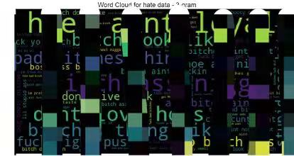
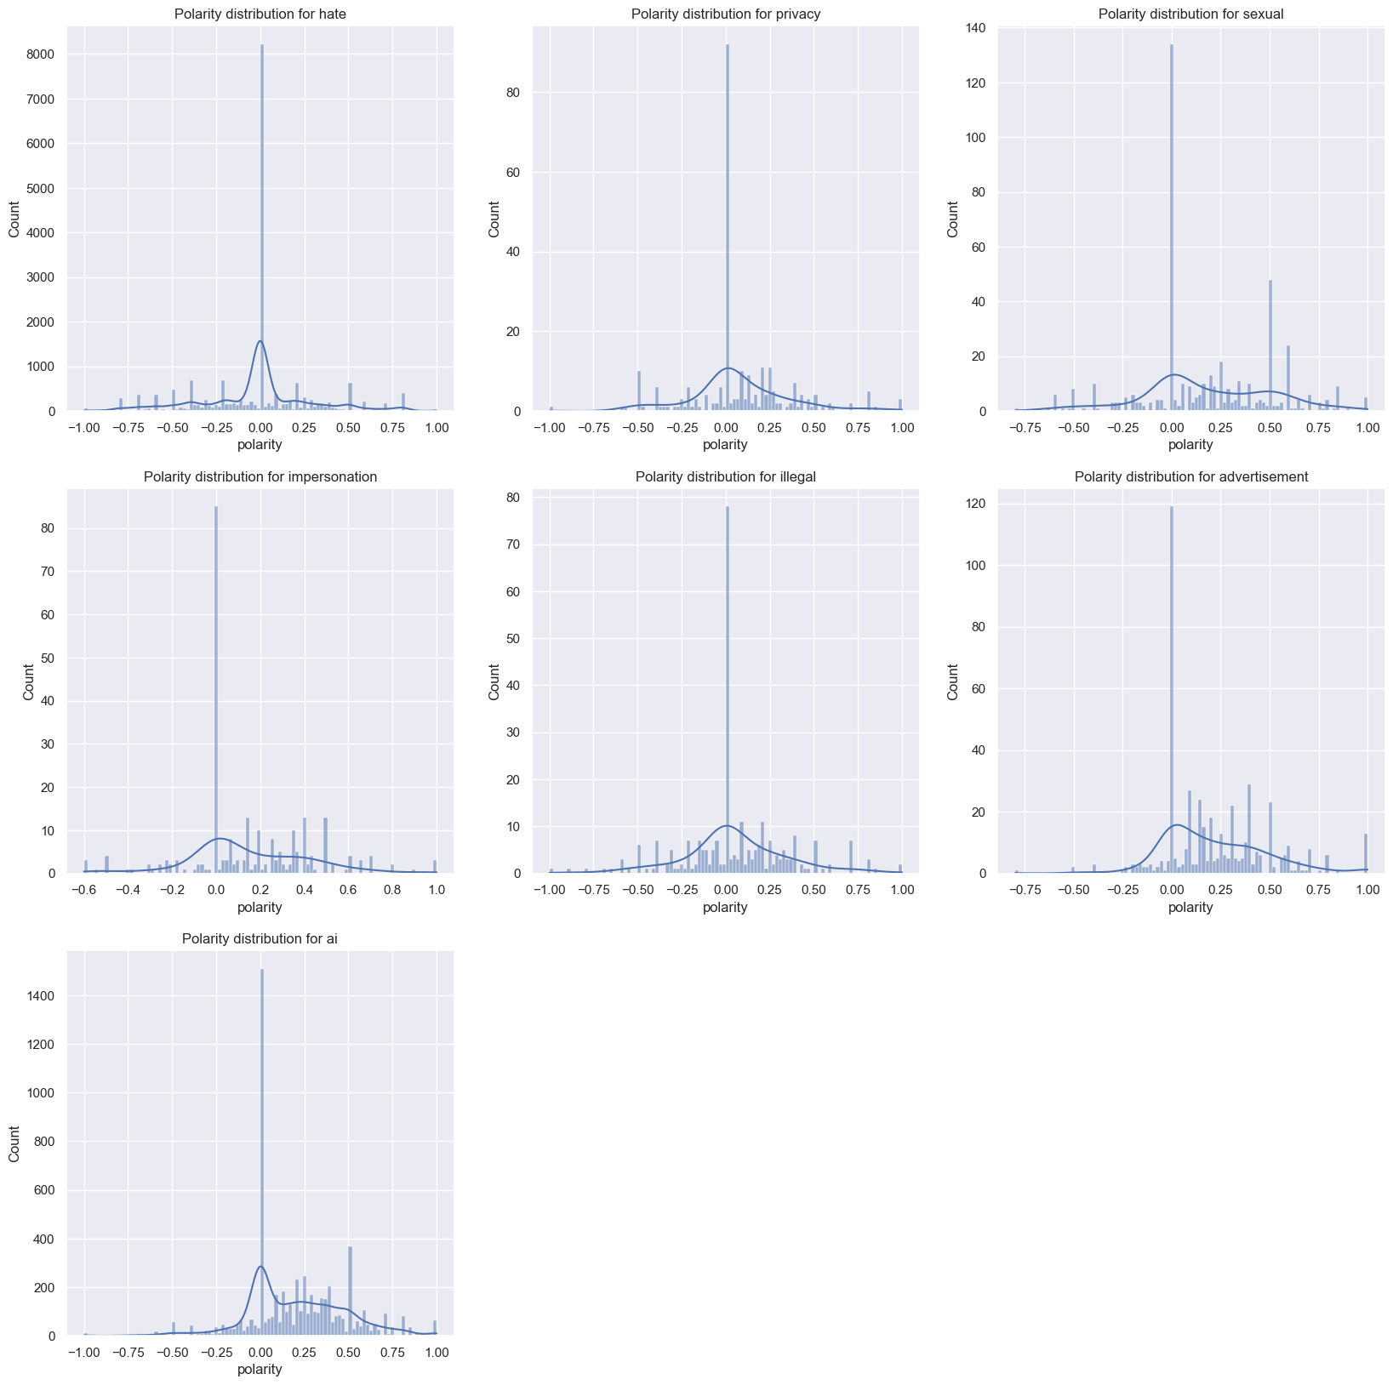
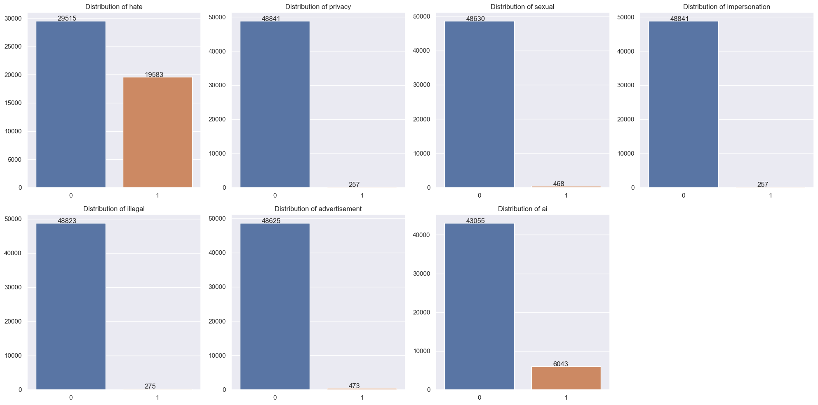
Data Exploration
Specific Vocabulary
Polarity
Data Imbalance

Slide 15
03
Models
Building, training and evaluation

Slide 16
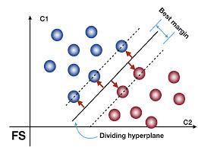
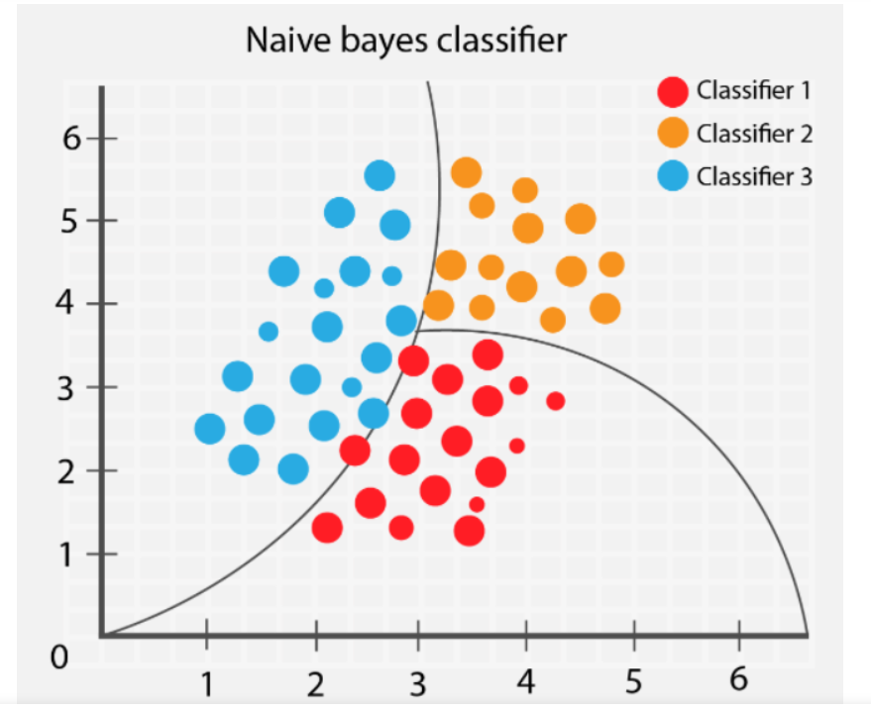
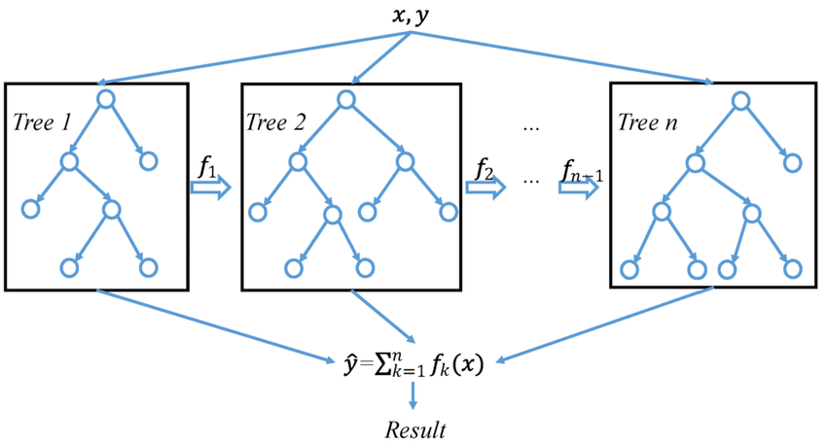
Baseline models
Naive Bayes
Passive Aggressive
XGBoost
Based on Bayes’ theorem using conditional probability
Updates the model incrementally, adapting to new data without retraining the entire model.
Gradient boosting algorithm known for high predictive accuracy and scalability
Simplicity and interpretability
sacrifice complexity and performance for complex tasks

Slide 17
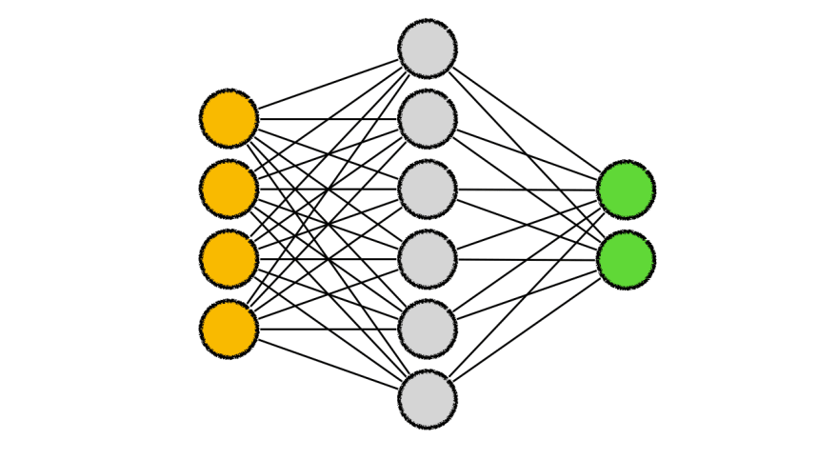
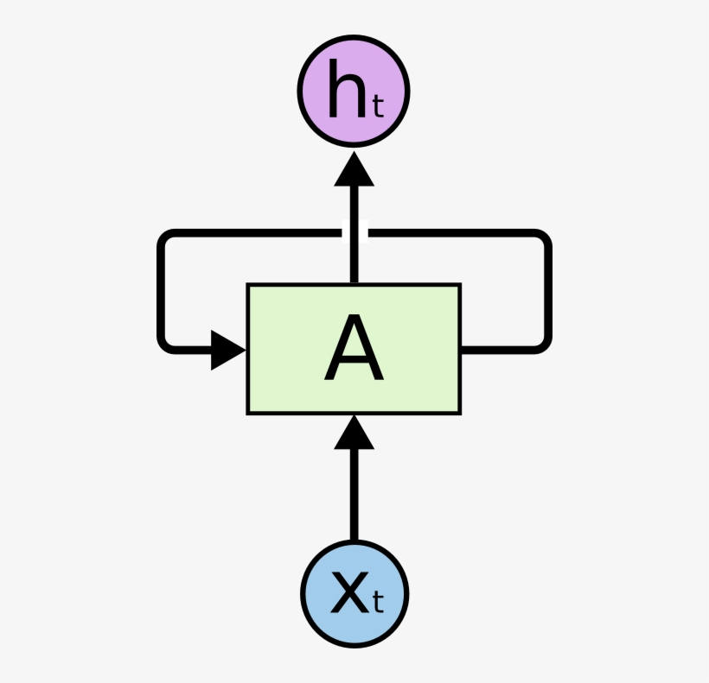
Deep Neural Network (CNN, LSTM)
CNN
A neural network architecture used for text processing aside from image processing
Uses convolutional layers to learn features from input data
Computationally efficient and can be trained on large text datasets
LSTM
Capture long-term dependencies in sequential data
Contains a memory cell that stores and updates information over time
Suitable for text processing task

Slide 18
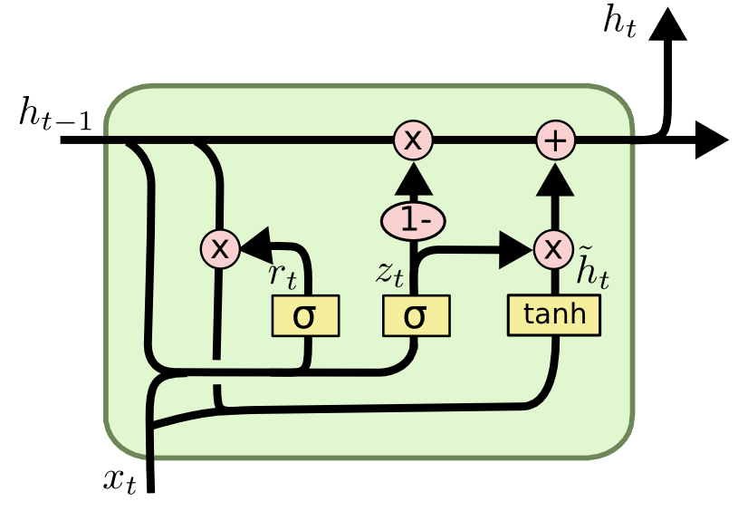
Gated Recurrent Unit (GRU)
Transformer encoder
Increased computational efficiency than LSTM
Attention + longer-range dependencies in text
n-gram tokenized Input
n-gram tokenized Input
Embedding
Embedding
Multi-head attention
Transformer encoder
4 encoder layers
w/ 4 attention heads each
GRU
Layer
GRU
Layer
x4 layers
Add & Norm
Feed-forward
FC Linear layer
FC Linear layer
Add & Norm

Slide 19
BERT and RoBERTa
Transfer learning
Overall architecture (sequence classification)
Tokens
WordPiece (BERT)
BPE (RoBERTa)
BERT (bert-base)
Bidirectional Encoder Representations from Transformers is a pre-trained (English corpus) masked language model to learn deep bidirectional representations from text data.
BERT/RoBERTa
12 transformer encoders
Dropout
FC Linear layer
(for RoBERTa only)
RoBERTa (roberta-base)
Optimized BERT approach with longer training time, larger pre-training corpus, with the same architecture.
Dropout
FC Linear layer

Slide 20
GroNLP/hateBERT
Model complexity
Specialised variant of BERT model which is pre-trained on a hate-speech corpus on top of an English BERT uncased model.
We trained 3 custom architectures:
1.
2.
3.
Fully connected layer
classifier
Layer normalization
Attention layer
Dropout
Fully connected layer
classifier
Position wise feedforward
Dropout
Layer normalization
x2
Sequential MLP
classifier

Slide 21
04
Evaluation
Model Performance, Limitations and Mitigations

Slide 22
Overall Models Results
Model | Macro Weighted
 | Precision | Recall | F1
Multinomial Naive Bayes | 0.27 | 0.17 | 0.20
PassiveAggressive | 0.67 | 0.55 | 0.60
XGBoost | 0.79 | 0.42 | 0.53
CNN | 0.33 | 0.31 | 0.32
GRU | 0.33 | 0.34 | 0.33
LSTM | 0.32 | 0.32 | 0.32
Basic Transformer | 0.68 | 0.52 | 0.55
BERT | 0.85 | 0.65 | 0.70
RoBERTa | 0.80 | 0.63 | 0.68
hateBERT Variant 1 | 0.79 | 0.79 | 0.79
hateBERT Variant 2 | 0.89 | 0.77 | 0.82
hateBERT Variant 3 | 0.81 | 0.69 | 0.72

Slide 23
hateBERT Cross Validation Scores
Labels/Violations | Precision | Recall | F1 | n
Hate Speech | 0.94 | 0.95 | 0.94 | 1958
Privacy | 0.66 | 0.73 | 0.69 | 26
Sexual | 0.67 | 0.57 | 0.61 | 46
Impersonation | 0.60 | 0.46 | 0.52 | 26
Illegal | 0.50 | 0.57 | 0.53 | 28
Advertisement | 0.78 | 0.83 | 0.80 | 47
AI Content | 0.98 | 0.98 | 0.98 | 684
Neutral | 0.94 | 0.93 | 0.94 | 2175

Slide 24
Limitations
Effective platform and content moderation effort by moderators, making violations data points scarce.
Mitigation: Utilised focal loss as our loss function to down-weight easy samples and up-weight difficult minority categories.
Scale and Diversity
Hinders the ability for the model to accurately detect minority classes.

Slide 25
Limitations
BERT-based transformer models are massive models with 340 million parameters.
Mitigation: Only conducted cross validation for our best performing model.
Hyperparameter Tuning
Lack of time and resources for extensive hyperparameter tuning

Slide 26
05
Demo
Ready to Use End-products

Slide 27
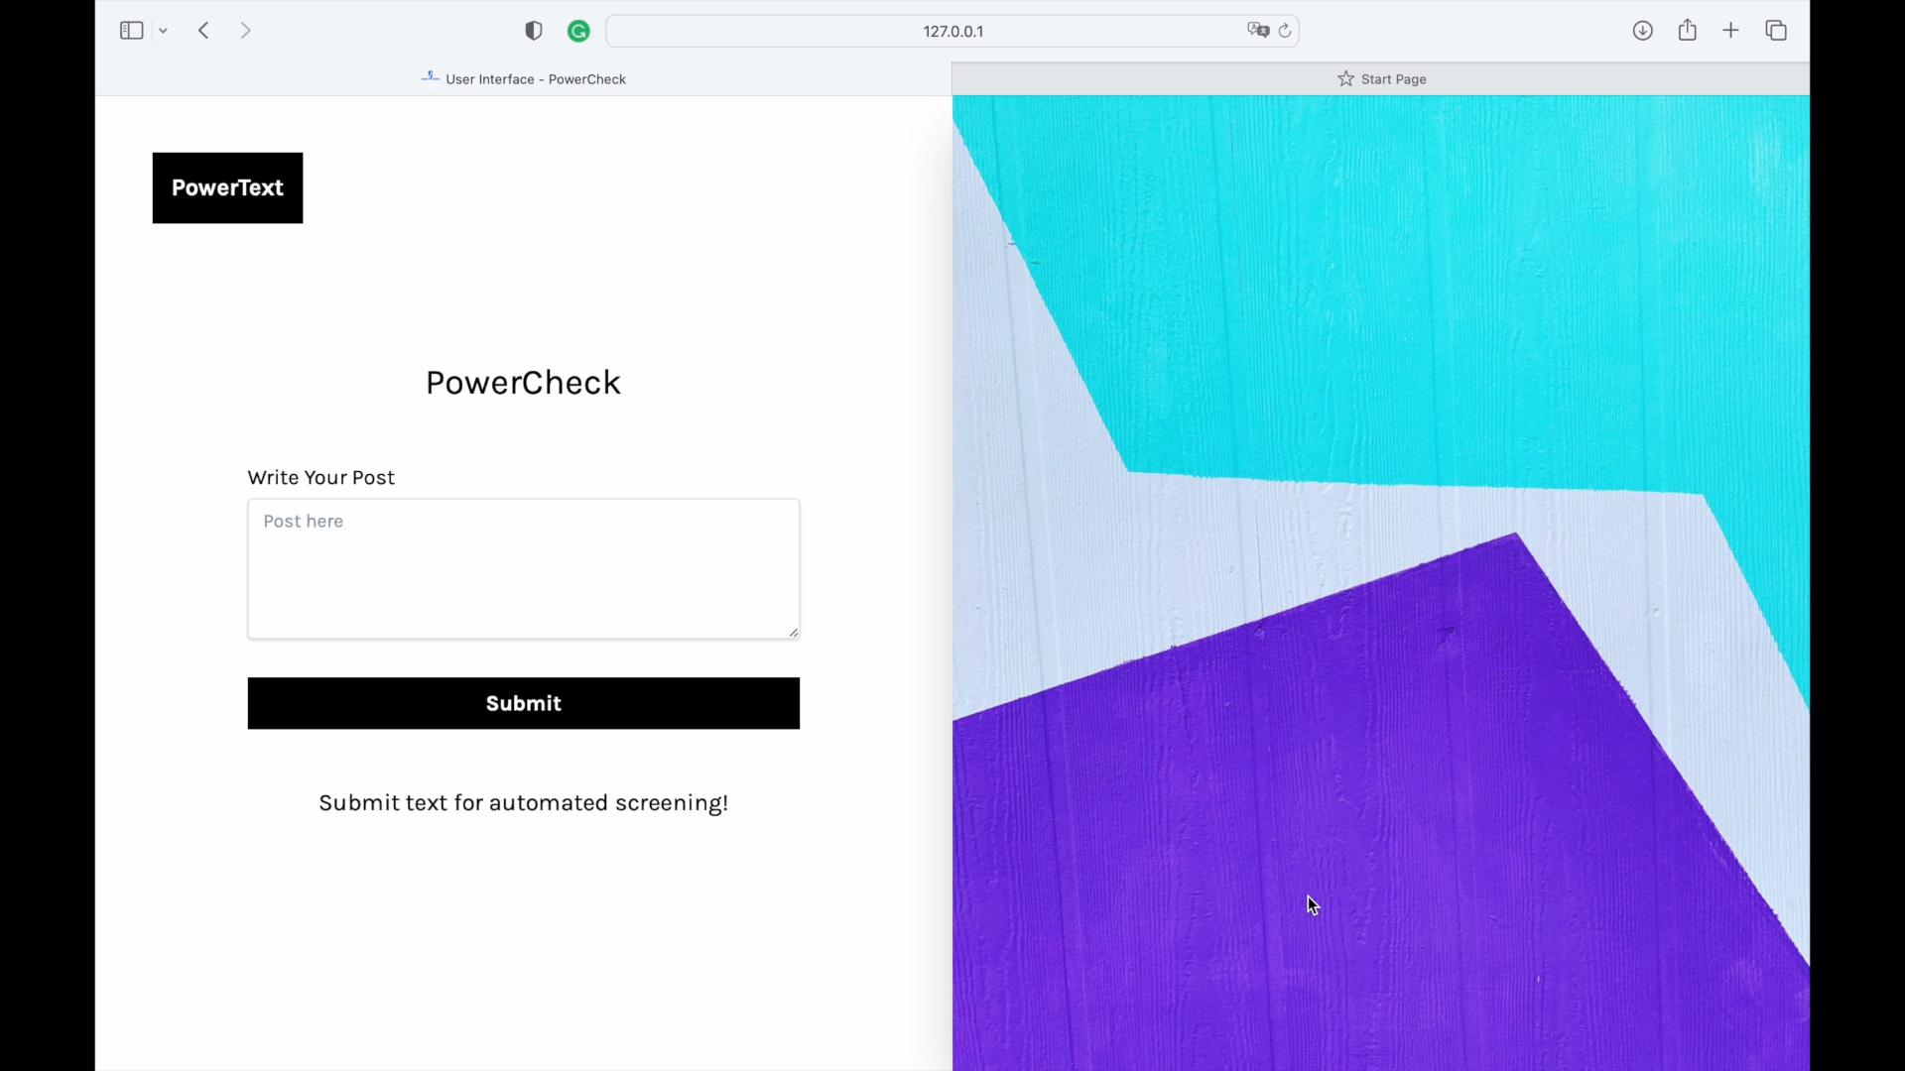
Product 1: Common User
TOS violation detection given text input.

Slide 28
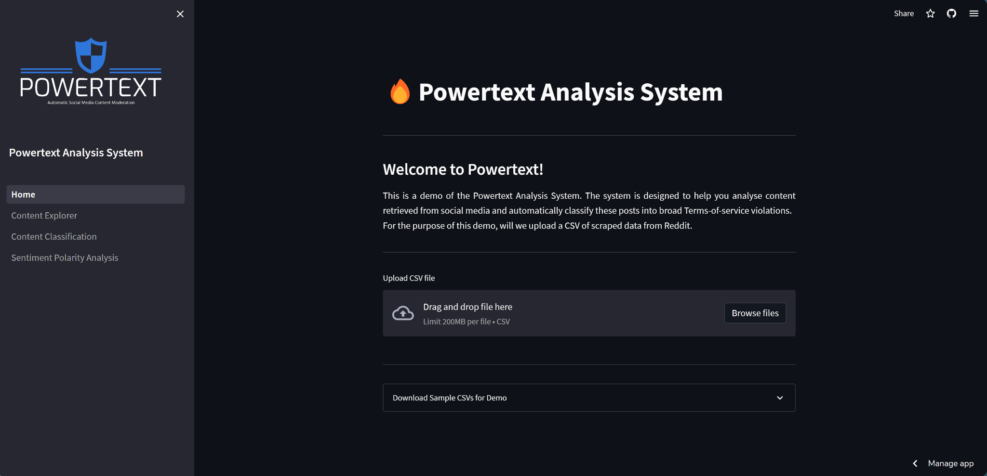
Product 2: Platform Regulators
Dashboard for automatic TOS violation management
Notes:
Deployed online! Link: https://bit.ly/is4242_analysis_system

Slide 29
06
Extensions
Our Glorious Vision and Ideas!

Slide 30
Future Extensions
Vision and Ideas
Further Automation
Post scraping
Data processing
Model retraining
Schedule using Apache Airflow
Further Analysis
User-level analysis
Time-series analysis
Data Management
Cloud database
User Autonomy
Time-frame selection
Subreddit selection
Sensitivity threshold
Enhance system robustness and usefulness!

Slide 31

Thanks!
[Ad Content Detected]
PowerText.Platform Online
Have a free trial now =>

